Slide 1

Topic 15
Electric Forces and Fields
(Part – 1)

Slide 2
Contents
15.1 Electric Charges, Insulators, and Conductors
15.2 Coulomb’s Law
15.3 Electric Fields
15.4 Electric Field Lines
15.5 Conductors in Electrostatic Equilibrium

Slide 3
Objectives
Understand the basic properties of electric charges.
Apply Coulomb’s Law to calculate the electric force between charged particles.
Describe and calculate the relationship between electric force and electric field for a point charge.
To draw the electric field lines for electric charge.

Slide 4
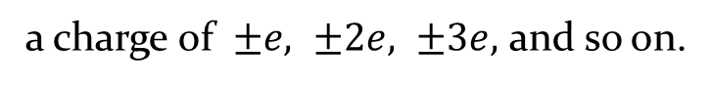
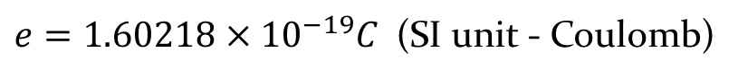
15.1 Electric Charges, Insulators, and Conductors
15.1.1 Properties of Electric Charges
Two knid of electric charges -
the electron has a charge of -e and the proton
has an equal and opposite charge of +e.
$e=1.60218×{10}^{−19}C$ (SI unit - Coulomb)
The electric charge is quantized -
a charge of $±e, ±2e, ±3e,$ and so on.
Electric charge is always conserved. Charge isn’t created . Negative charge is transferred from one object to the other.
Like charges repel one another and unlike charges attract one another.

Slide 5
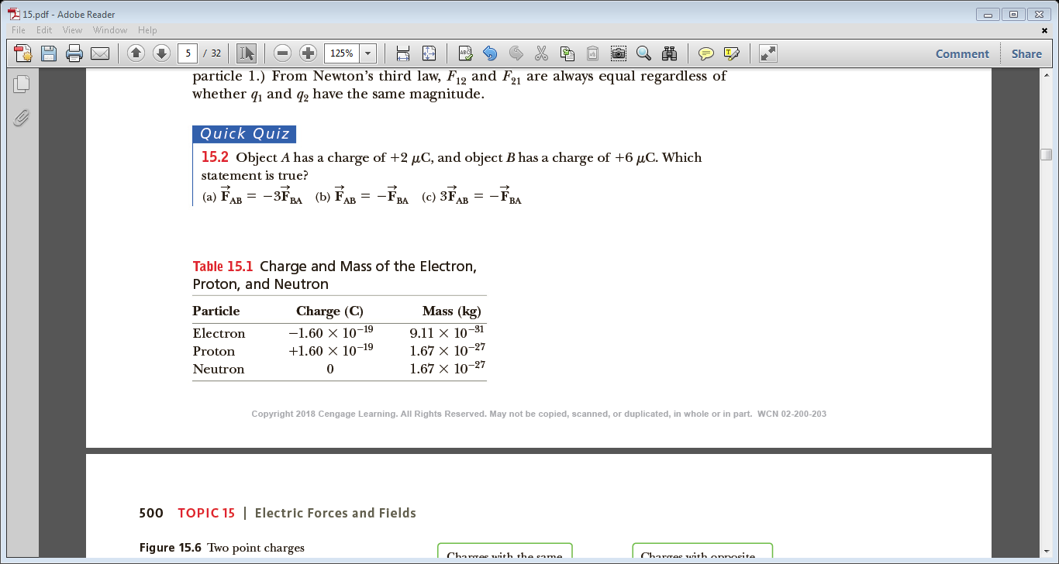
A solid, protons never move from one material to another. Electrons are far lighter than protons and hence more easily accelerated by forces. The objects become charged by gaining or losing electrons.
These experiments work best on a dry day because excessive moisture can facilitate a leaking away of the charge.
- a plastic comb through your hair, the comb attracts bits of paper.
- rubbing your shoes on a wool rug or by sliding across a car seat.
Charge and Mass of the electron, proton and neutron

Slide 6
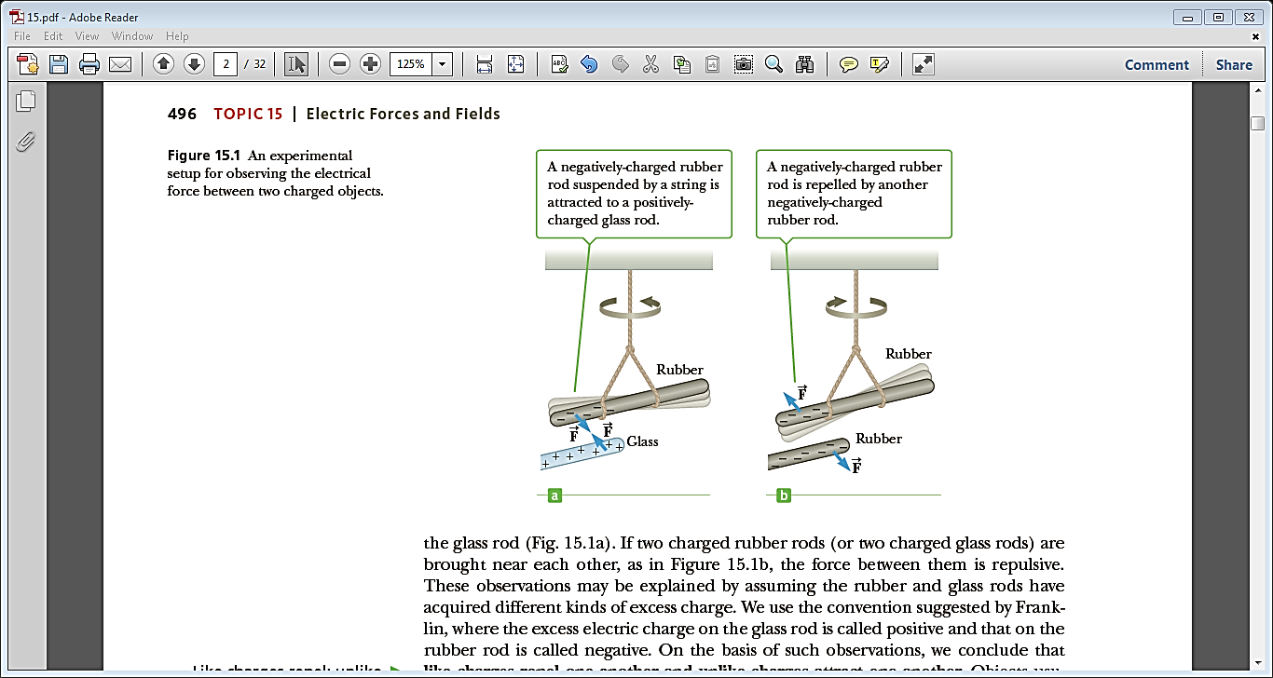
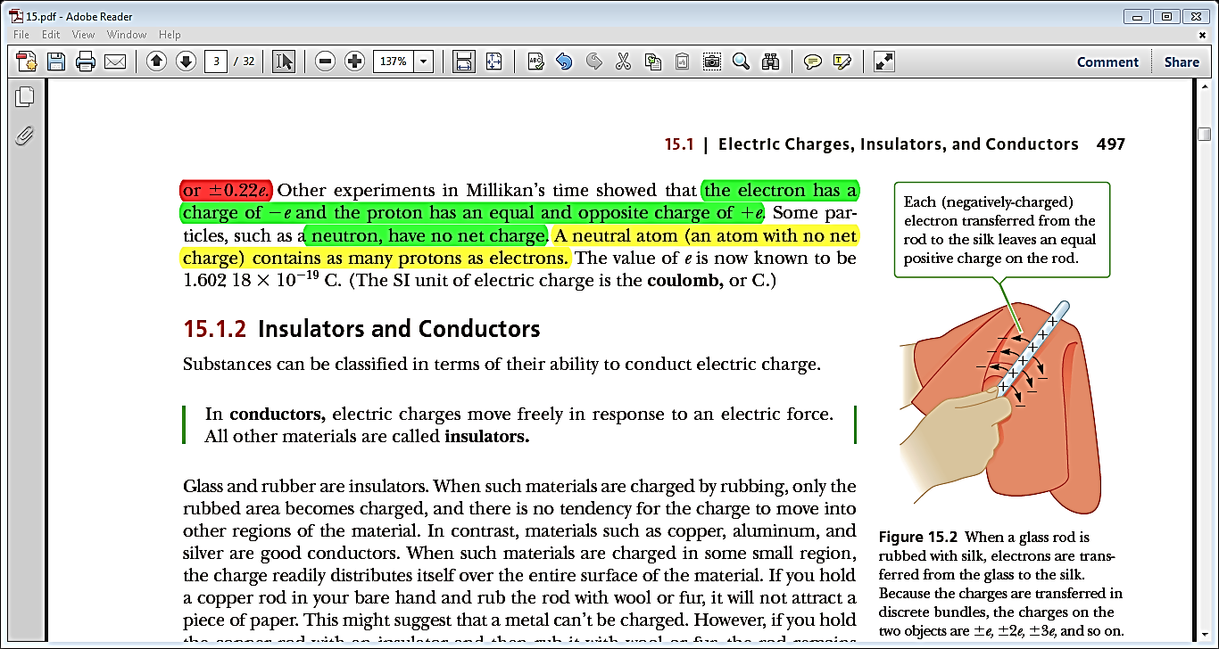
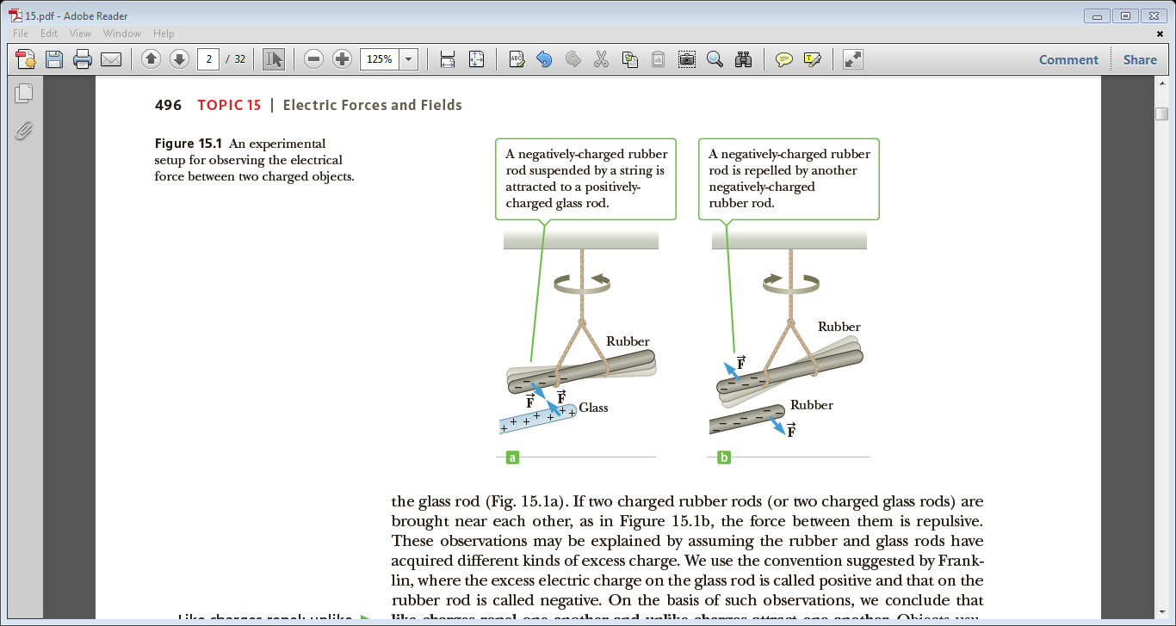

Slide 7
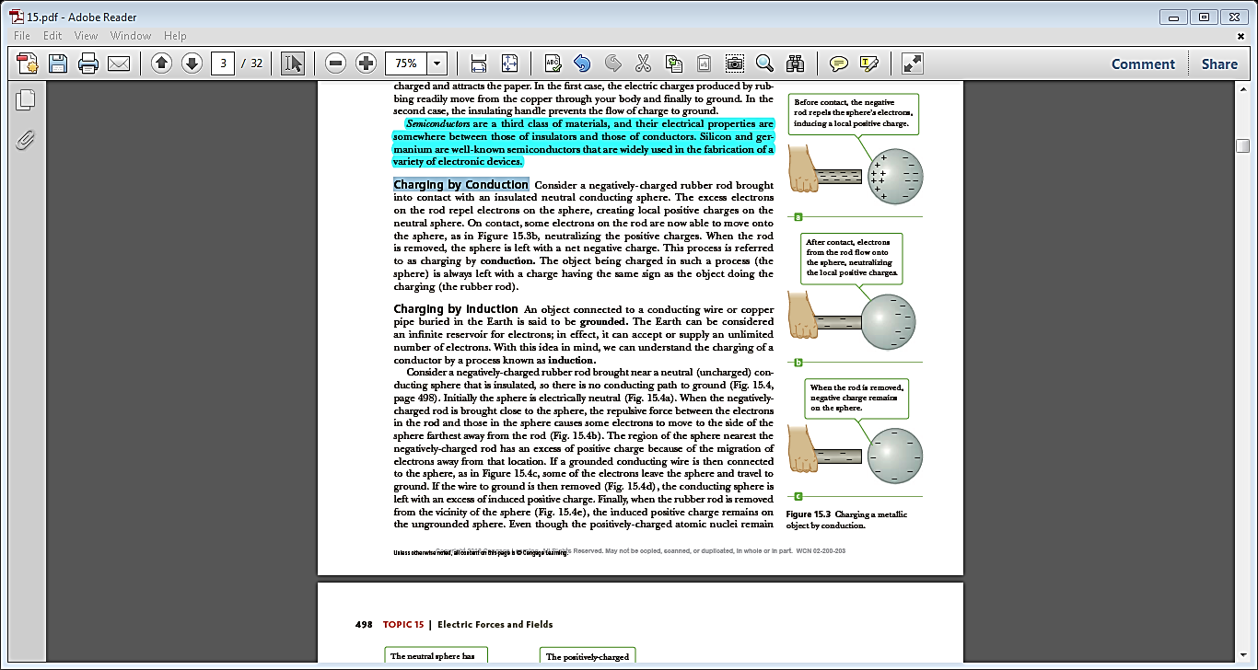
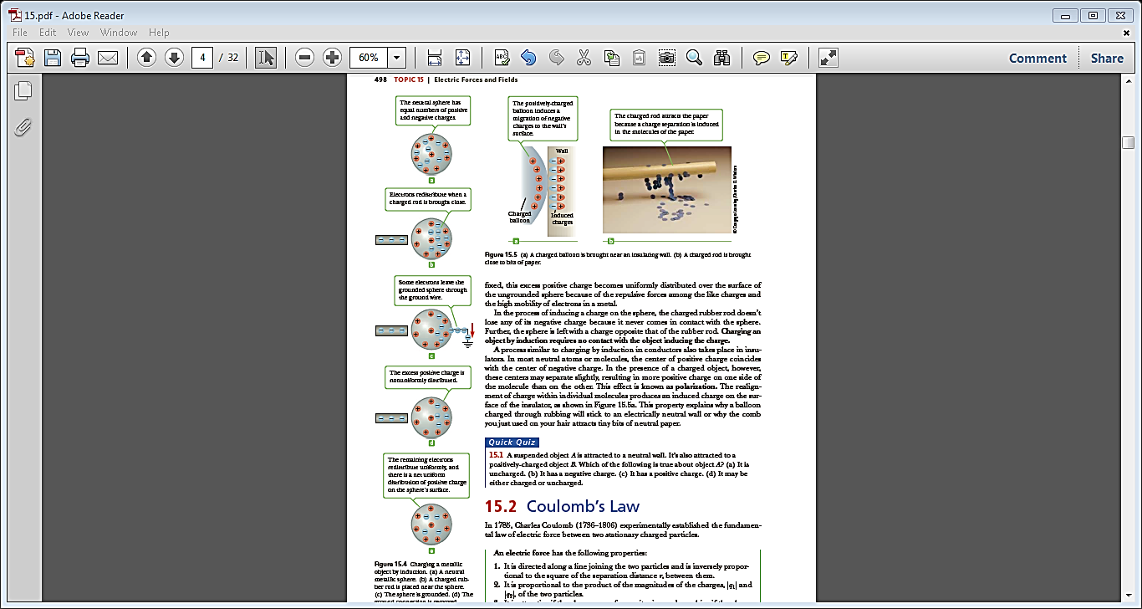
Charging by Conduction
Charging by Induction

Slide 8
15.1.2 Insulators and Conductors
Conductors - electric charges move freely in response to an electric force.
(copper, aluminum and silver are good conductors)
a material or a device which does not readily conduct electricity.
Insulators -
(paper , plastic , glass ,rubber , … etc.)
are a third class of materials and their electrical properties are somewhere between those of insulators and those of conductors and that are widely used in the fabrication of a variety of electronic devices.
(eg - Silicon and germanium)
Semiconductors -

Slide 9
Quick Quiz - 15.1
A suspended object A is attracted to a neutral wall. It’s also attracted to a positively - charged object B. Which of the following is true about object A? (a) It is uncharged. (b) It has a negative charge. (c) It has a positive charge. (d) It may be either charged or uncharged.
Answer - (b)
Object A must have a net charge because two neutral objects do not attract each other. Since object A is attracted to positively-charged object B, the net charge on A must be negative.

Slide 10
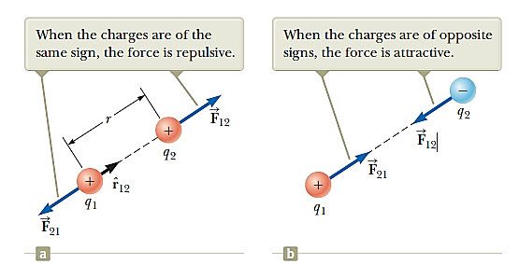
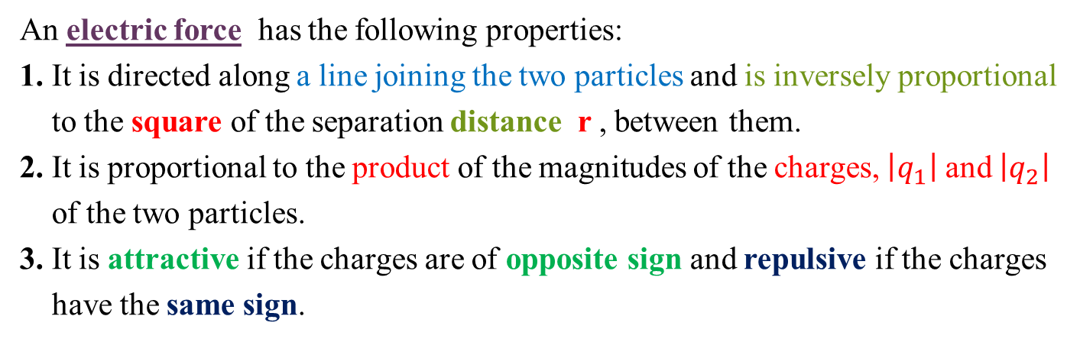
15.2 Coulomb’s Law
An electric force has the following properties:
1. It is directed along a line joining the two particles and is inversely proportional
to the square of the separation distance r , between them.
2. It is proportional to the product of the magnitudes of the charges, $\left|q_{1}\right|$ and $\left|q_{2}\right|$
of the two particles.
3. It is attractive if the charges are of opposite sign and repulsive if the charges
have the same sign.
Figure 15.6
Two point charges separated by a distance r exert a force on each other given by Coulomb’s law. The force on q₁ is equal in magnitude and opposite in direction to the force on q₂.

Slide 11
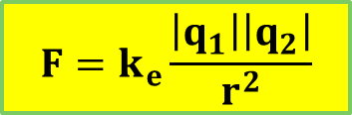
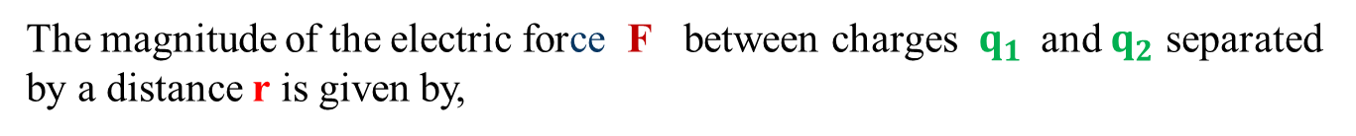
The magnitude of the electric force F between charges $q_{1}$and $q_{2}$ separated by a distance r is given by,
$$F=k_{e}\frac{\left|q_{1}\right|\left|q_{2}\right|}{r^{2}}$$
$Coulomb constant, { k}_{e}=8.9876×{10}^{9}Nm^{2}/C^{2}$
The SI unit of electric force is Newton (N).

Slide 12
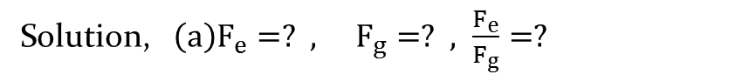
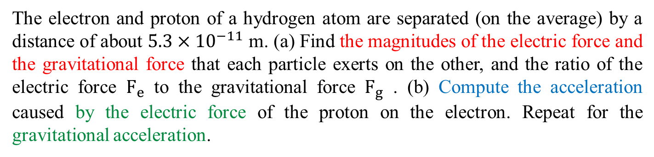
Example-15.1
The electron and proton of a hydrogen atom are separated (on the average) by a distance of about $5.3×{10}^{−11}$ m. (a) Find the magnitudes of the electric force and the gravitational force that each particle exerts on the other, and the ratio of the electric force $F_{e}$ to the gravitational force $F_{g}$ . (b) Compute the acceleration caused by the electric force of the proton on the electron. Repeat for the gravitational acceleration.
Solution, $\left(a\right)F_{e}=? , F_{g}=? , \frac{F_{e}}{F_{g}}=?$
$$F_{e}=k_{e}\frac{\left|q_{1}\right|\left|q_{2}\right|}{r^{2}}=k_{e}\frac{{\left|e\right|}^{2}}{r^{2}}=\left(8.99×{10}^{9}\right)\frac{{\left(1.6×{10}^{−19}\right)}^{2}}{{\left(5.3×{10}^{−11}\right)}^{2}}=8.2×{10}^{−8}N$$
$$F_{g}=G\frac{m_{e}m_{p}}{r^{2}}=\left(6.67×{10}^{−11}\right)\frac{\left(9.11×{10}^{−31}\right)\left(1.67×{10}^{−27}\right)}{{\left(5.3×{10}^{−11}\right)}^{2}}=3.6×{10}^{−47}N$$

Slide 13
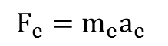
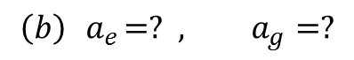
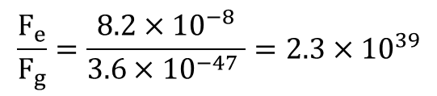
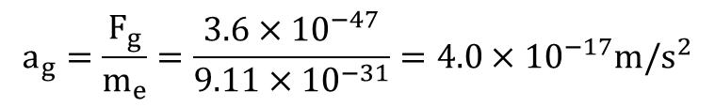
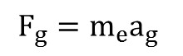
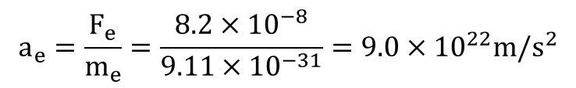
$$\frac{F_{e}}{F_{g}}=\frac{8.2×{10}^{−8}}{3.6×{10}^{−47} }=2.3×{10}^{39}$$
$$\left(b\right) { a}_{e}=? , a_{g}=?$$
$$F_{e}=m_{e}a_{e}$$
$$a_{e}=\frac{F_{e}}{m_{e}}=\frac{8.2×{10}^{−8}}{9.11×{10}^{−31}}=9.0×{10}^{22}m/s^{2}$$
$$F_{g}=m_{e}a_{g}$$
$$a_{g}=\frac{F_{g}}{m_{e}}=\frac{3.6×{10}^{−47}}{9.11×{10}^{−31}}=4.0×{10}^{−17}m/s^{2}$$

Slide 14
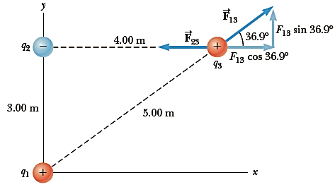
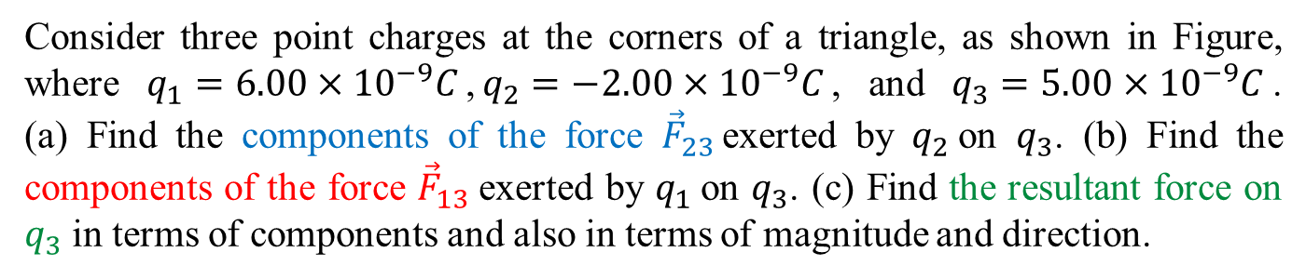
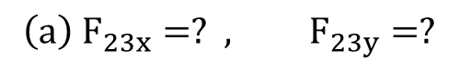
Example-15.3
Consider three point charges at the corners of a triangle, as shown in Figure, where $q_{1}=6.00×{10}^{−9}C$,$q_{2}=−2.00×{10}^{−9}C$, and $q_{3}=5.00×{10}^{−9}C$. (a) Find the components of the force ${\vec{F}}_{23 }$exerted by $q_{2}$on $q_{3}$. (b) Find the components of the force ${\vec{F}}_{13}$exerted by $q_{1}$on $q_{3}$. (c) Find the resultant force on $q_{3}$ in terms of components and also in terms of magnitude and direction.
Solution,
$$\left(a\right) F_{23x}=? , F_{23y}=?$$

Slide 15
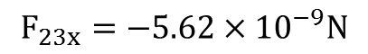
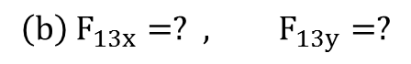
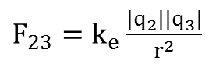
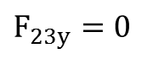
$F_{23}=k_{e}\frac{\left|q_{2}\right|\left|q_{3}\right|}{r^{2}}$
$F_{23}=\left(8.99×{10}^{9}\right)\frac{\left(2.00×{10}^{−9}\right)\left(5.00×{10}^{−9}\right)}{{\left(4.00\right)}^{2}}=5.62×{10}^{−9}N$
$$F_{23x}=−5.62×{10}^{−9}N$$
$$F_{23y}=0$$
$$\left(b\right) F_{13x}=? , F_{13y}=?$$
$F_{13}=k_{e}\frac{\left|q_{1}\right|\left|q_{3}\right|}{r^{2}}=\left(8.99×{10}^{9}\right)\frac{\left(6.00×{10}^{−9}\right)\left(5.00×{10}^{−9}\right)}{{\left(5.00\right)}^{2}}=1.08×{10}^{−8}N$
$F_{13x}=F_{13}cosθ=\left(1.08×{10}^{−8}\right)\cos\left(36.9°\right)=8.64×{10}^{−9}N$
$F_{13y}=F_{13}sinθ=\left(1.08×{10}^{−8}\right)\sin\left(36.9°\right)=6.48×{10}^{−9}N$

Slide 16
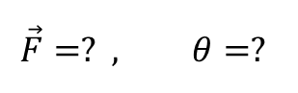
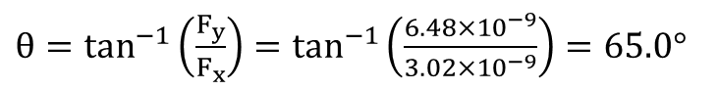
(c) the resultant force,
$$\vec{F}=? , θ=?$$
$$F_{x}=F_{13x}−F_{23x}=8.64×{10}^{−9}−5.62×{10}^{−9}=3.02×{10}^{−9}N$$
$$F_{y}=F_{13y}+F_{23y}=6.48×{10}^{−9}+0=6.48×{10}^{−9}N$$
$\vec{F}=\sqrt{{F_{x}}^{2}+{F_{y}}^{2}}=\sqrt{{\left(3.02×{10}^{−9} \right)}^{2}+{\left(6.48×{10}^{−9} \right)}^{2}}=7.15×{10}^{−9}N$
$θ=\tan^{−1}\left(\frac{F_{y}}{F_{x}}\right)=\tan^{−1}\left(\frac{6.48×{10}^{−9}}{3.02×{10}^{−9}}\right)=65.0°$

Slide 17
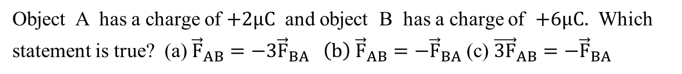
Quick Quiz - 15.2
Object A has a charge of $+2μC$ and object B has a charge of $+6μC.$ Which statement is true? (a) ${\vec{F}}_{AB}=−3{\vec{F}}_{BA} \left(b\right) {\vec{F}}_{AB}=−{\vec{F}}_{BA}$(c) ${\vec{3F}}_{AB}=−{\vec{F}}_{BA}$
Answer - (b)
By Newton’s third law, the two objects will exert forces having equal magnitudes but opposite directions on each other.

Slide 18
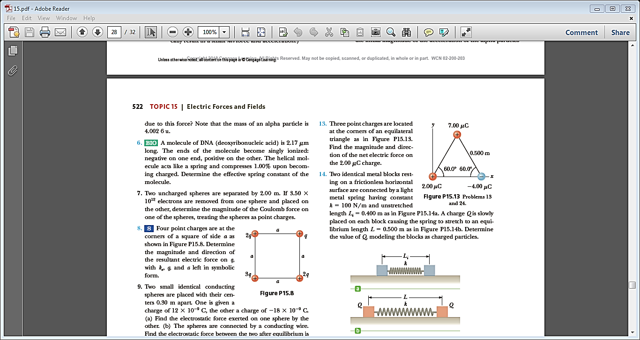
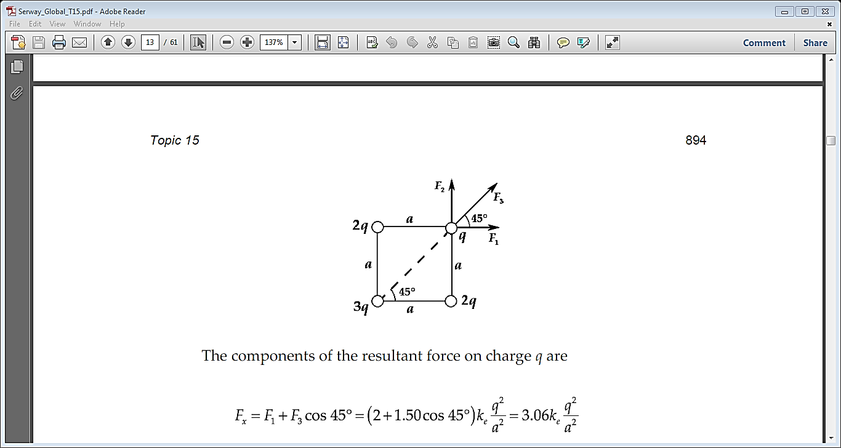
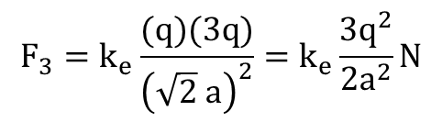
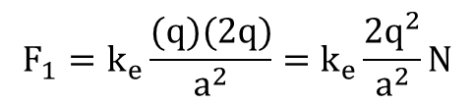
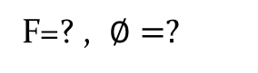
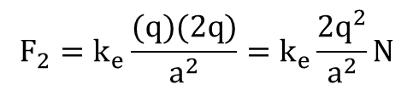
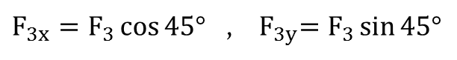
Problem-6
Four point charges are at the corners of a square of side a as shown in Figure. Determine the magnitude and direction of the resultant electric force on q, with k_{e} , q, and a left in symbolic form.
Solution,
F=? , $∅=?$
$$F_{1}=k_{e}\frac{(q)(2q)}{a^{2}}=k_{e}\frac{2q^{2}}{a^{2}}N$$
$$F_{2}=k_{e}\frac{(q)(2q)}{a^{2}}=k_{e}\frac{2q^{2}}{a^{2}}N$$
$$F_{3}=k_{e}\frac{(q)(3q)}{{\left(\sqrt{2} a\right)}^{2}}=k_{e}\frac{3q^{2}}{{2a}^{2}}N$$
$F_{3x}=F_{3}\cos{45° }$ , ${ F}_{3y}=F_{3}\sin{45°}$

Slide 19
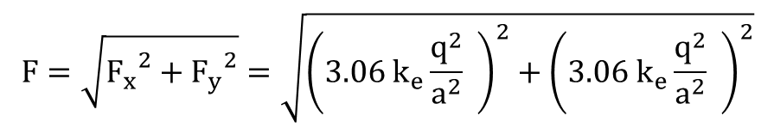
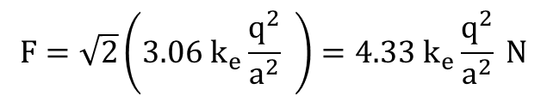
$$F_{x}=F_{1}+F_{3x}=k_{e}\frac{2q^{2}}{a^{2}}+k_{e}\frac{3q^{2}}{{2a}^{2}}\cos{45°=k_{e}\frac{q^{2}}{a^{2}}\left(2+\frac{3}{2}\cos{45° }\right)=3.06{ k}_{e}\frac{q^{2}}{a^{2}}}$$
$$F_{y}=F_{2}+F_{3y}=k_{e}\frac{2q^{2}}{a^{2}}+k_{e}\frac{3q^{2}}{{2a}^{2}}\sin{45° }=k_{e}\frac{q^{2}}{a^{2}}\left(2+\frac{3}{2}\sin{45° }\right)=3.06{ k}_{e}\frac{q^{2}}{a^{2}}$$
The magnitude of resultant force is,
$$F=\sqrt{{F_{x}}^{2}+{F_{y}}^{2}}=\sqrt{{\left(3.06{ k}_{e}\frac{q^{2}}{a^{2}} \right)}^{2}+{\left(3.06{ k}_{e}\frac{q^{2}}{a^{2}} \right)}^{2}}$$
$$F=\sqrt{2}\left(3.06{ k}_{e}\frac{q^{2}}{a^{2}} \right)=4.33{ k}_{e}\frac{q^{2}}{a^{2}} N$$
It is directed at $∅=\tan^{−1}\left(\frac{F_{y}}{F_{x}}\right){=\tan^{−1}\left(1.00\right)}=45°$above the horizontal

Slide 20
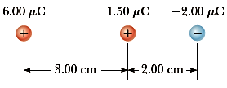
Problem-8
Calculate the magnitude and direction of the Coulomb force on each of the three charges shown in Figure.
Solution, F = ? (on each charge)

Slide 21
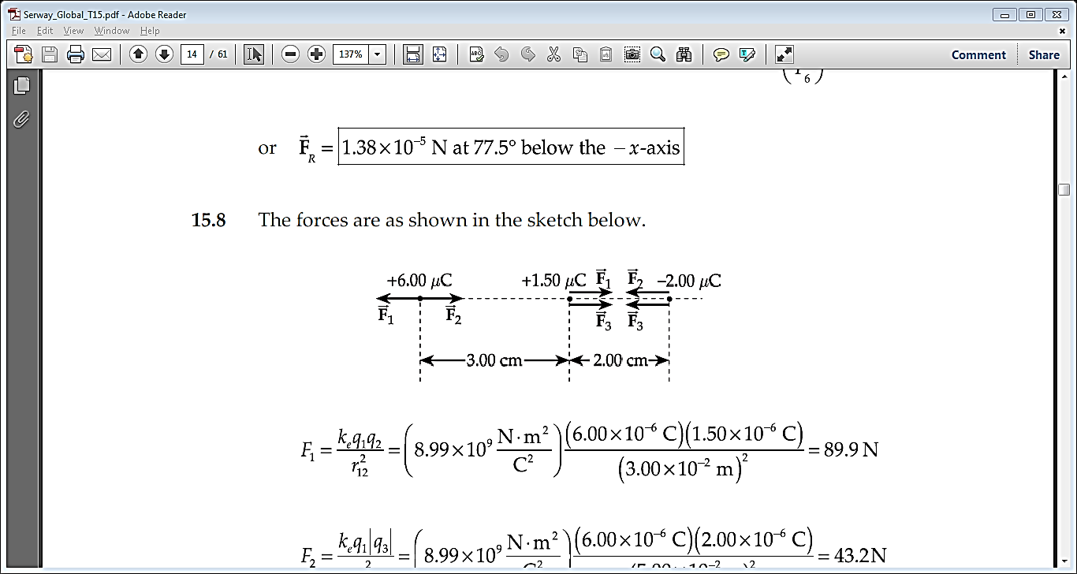
$$F_{1}=k_{e}\frac{\left|q_{1}\right|\left|q_{2}\right|}{{r_{12}}^{2}}=\left(8.99×{10}^{9}\right)\frac{\left(6.00×{10}^{−6}\right)\left(1.50×{10}^{−6}\right)}{{\left(3.00×{10}^{−2}\right)}^{2}}=89.9N$$
$$F_{2}=k_{e}\frac{\left|q_{1}\right|\left|q_{3}\right|}{{r_{13}}^{2}}=\left(8.99×{10}^{9}\right)\frac{\left(6.00×{10}^{−6}\right)\left(2.00×{10}^{−6}\right)}{{\left(5.00×{10}^{−2}\right)}^{2}}=43.2N$$
$$F_{3}=k_{e}\frac{\left|q_{2}\right|\left|q_{3}\right|}{{r_{23}}^{2}}=\left(8.99×{10}^{9}\right)\frac{\left(1.50×{10}^{−6}\right)\left(2.00×{10}^{−6}\right)}{{\left(2.00×{10}^{−2}\right)}^{2}}=67.4N$$

Slide 22
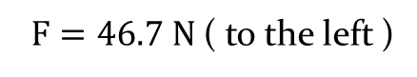
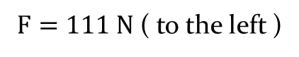
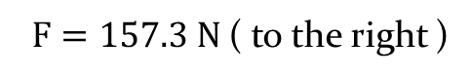
The net force on the 6$μC$charge , F $=−F_{1}+F_{2}=−89.9+43.2=−46.7 N$
$F=46.7 N$( to the left )
The net force on the $1.5μC$charge , F $=F_{1}+F_{3}=89.9+67.4=157.3 N$
$F=157.3 N$( to the right )
The net force on the $−2μC$charge , F $=−F_{2}−F_{3}=−43.2−67.4=−110.6 N$
$F=111 N$( to the left )

Slide 23
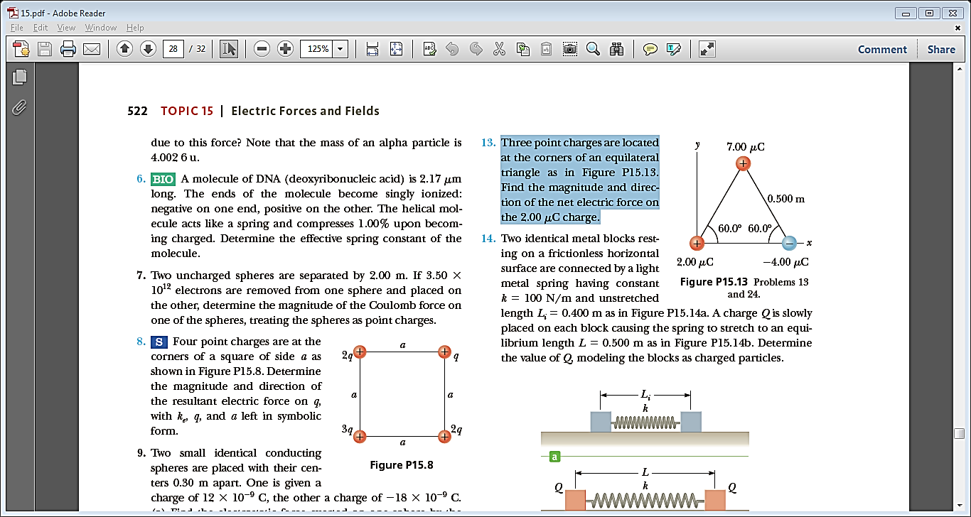
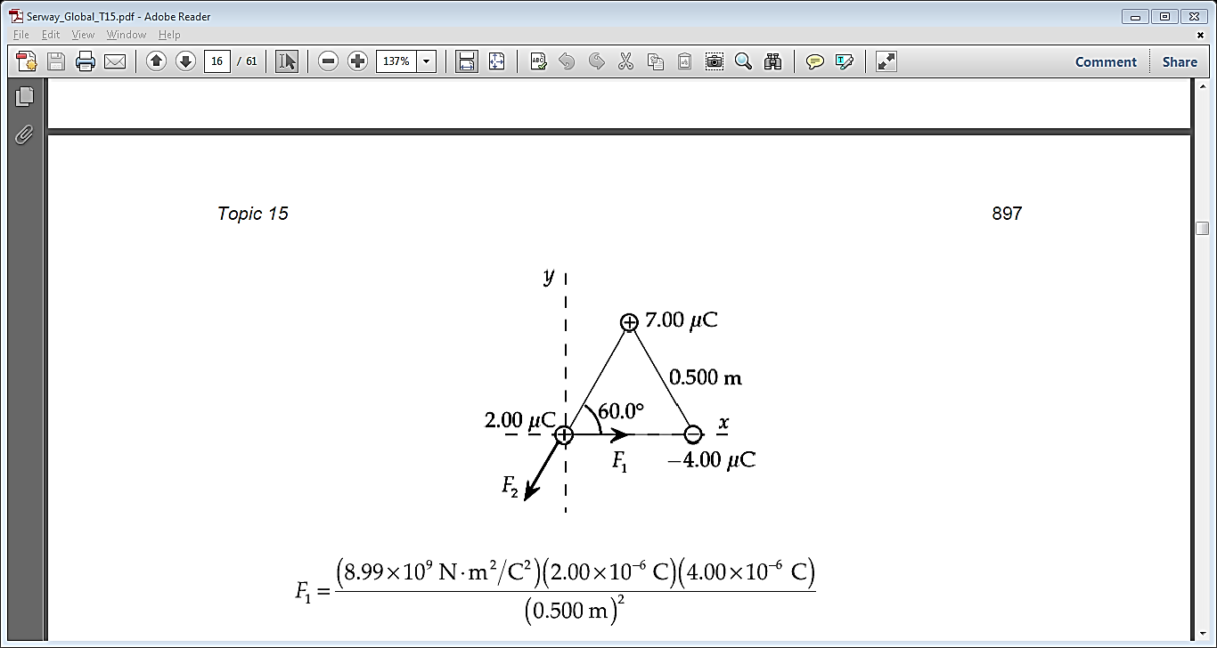
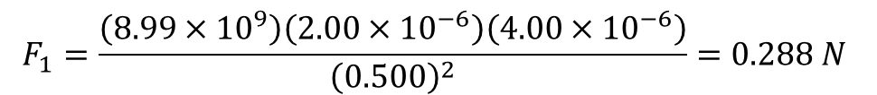
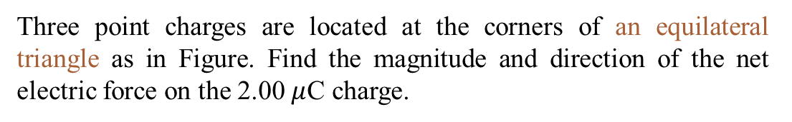
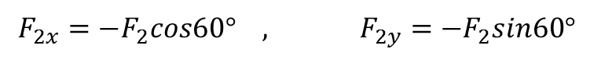
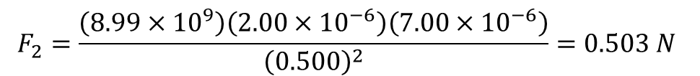
Problem-11
Three point charges are located at the corners of an equilateral triangle as in Figure. Find the magnitude and direction of the net electric force on the 2.00 $μ$C charge.
Solution, F=? , $θ=?$(on the 2.00 $μ$C charge )
$$F_{1}=\frac{\left(8.99×{10}^{9}\right)\left(2.00×{10}^{−6}\right)\left(4.00×{10}^{−6}\right)}{{\left(0.500\right)}^{2}}=0.288 N$$
$$F_{2}=\frac{\left(8.99×{10}^{9}\right)\left(2.00×{10}^{−6}\right)\left(7.00×{10}^{−6}\right)}{{\left(0.500\right)}^{2}}=0.503 N$$
$$F_{2x}={−F}_{2}cos60° , F_{2y}={−F}_{2}sin60°$$

Slide 24



$$F_{x}=F_{1}−F_{2x}=0.288−0.503cos60°=3.65×{10}^{−2}N=0.0365 N$$
$$F_{y}=F_{2y}=−F_{2}sin60°=−0.503sin60°=−0.436 N$$
$$F=\sqrt{{F_{x}}^{2}+{F_{y}}^{2}}=\sqrt{{\left(0.0365\right)}^{2}+{\left(−0.436\right)}^{2}}=0.438 N$$
$$θ=\tan^{−1}\left(\frac{F_{y}}{F_{x}}\right)=\tan^{−1}\left(\frac{−0.436}{0.0365}\right)=−85.2°$$
$θ=85.2°$ below the +x axis

Slide 25
Problems
Examples: 1,3,5 (3)
Problems: 6,8,11,18,25,36 (6)
Total: (9)
Assignment:

